Slide 1
MACHINE LEARNING
@AJAYANDRA

Slide 2
INTRODUCTION
Machine learning is the subfield of computer science that gives "computers the ability to learn without being explicitly programmed.”

Slide 3
How ML works?
Prior to machine learning, each image would be transformed to a vector of features
Feature Extraction
Instead Set of Rules, ML model is used

Slide 4
Examples of ML
Recommendation System
Search Suggestions
Loan Application
Chatbot, Etc.

Slide 5
Major ML techniques
Regression/Estimation
Predicting Continuous Values
Classification
Predicting the item class/category of a case
Clustering
Finding the structure of data; summarization
Associations
Associating frequent co-occurring items/events

Slide 6
Major ML techniques
Anomaly detection
Discovering abnormal and unusual cases
Sequence mining
Predicting next events; click-stream (Markov Model, HMM)
Dimension reduction
Reducing the size of data (PCA)
Recommendation systems
Recommending items

Slide 7
ML using Python
Numpy
Scipy
Pandas
Matpltlib
Scikit-learn

Slide 8
scikit-learn
FOSS ML library
Classification, Regression and Clustering algorithms
Works with Numpy & Scipy
Easy to implement

Slide 9
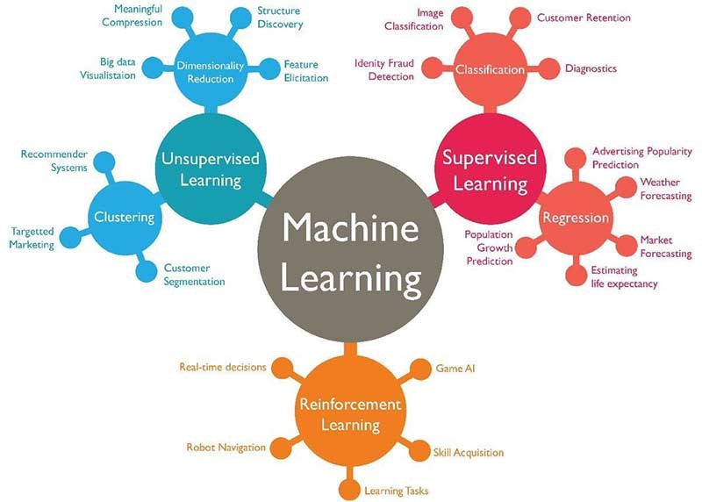
ML Approches

Slide 10
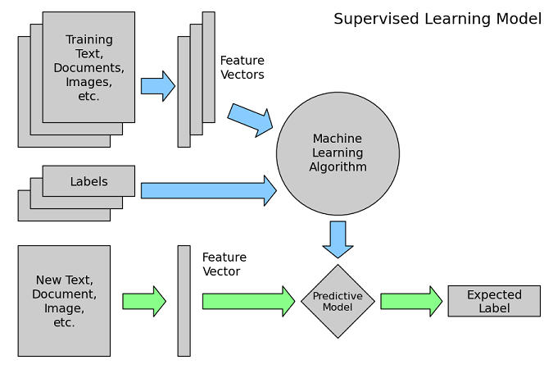
Supervised learning “teach the model”

Slide 11
Which are the two types of Supervised learning techniques?
Classification and Clustering
Classification and K-Means
Regression and Clustering
Regression and Partitioning
Classification and Regression
Which of the following statements best describes the Python scikit library?
A library for scientific and high-performance computation
A collection of algorithms and tools for machine learning
A popular plotting package that provides 2D plotting as well as 3D plotting
A library that provides high-performance, easy to use data structures
A collection of numerical algorithms and domain-specific toolboxes.

Slide 12
Regression
Regression is the process of predicting a continuous value

Slide 13
Types of Regression model
Simple Regression
Simple Linear Regression
Simple Non-Linear Regression
Multiple Regression
Multiple Linear Regression
Multiple Non-Linear Regression

Slide 14
Applications of Regression
Sales forecasting
Satisfaction analysis
Price estimation
Employment income

Slide 15
Regression algorithms
Ordinal regression
Poisson regression
Fast forest quantile regression
Linear, Polynomial, Lasso, Stepwise, Ridge regression
Bayesian linear regression
Neural network regression
Decision forest regression
Boosted decision tree regression
KNN (K-nearest neighbors)

Slide 16
Simple Linear Regression
Linear regression is the approximation of a linear model used to describe the relationship between two or more variables. In simple linear regression, there are two variables: a dependent variable and an independent variable

Slide 17
Linear regression topology
Simple Linear Regression:
Predict co2emission vs EngineSize of all cars
Independent variable (x): EngineSize
Dependent variable (y): co2emission
Multiple Linear Regression:
Predict co2emission vs EngineSize and Cylinders of all cars
Independent variable (x): EngineSize, Cylinders, etc
Dependent variable (y): co2emission

Slide 18
Examples of multiple linear regression
Independent variables effectiveness on prediction
Does revision time, test anxiety, lecture attendance and gender have any effect on the exam performance of students?
Predicting impacts of changes
How much does blood pressure go up (or down) for every unit increase (or decease) in the BMI of a patient?

Slide 19
Estimating multiple linear regression parameters
How to estimate?
Ordinary Least Squares
Linear algebra operations
Optimization Algorithm
Gradient Descent

Slide 20
Q&A – on multiple linear regression
How to determine whether to use simple or multiple linear regression?
How many independent variables should you use?
Should the independent variable be continuous?
What are the linear relationships between the dependent variable and the independent variables?

Slide 21
Model evaluation approaches
Train and Test on the Same Dataset
Train/Test Split
Regression Evaluation Metrics

Slide 22
Regression Evaluation Metrics
Mean absolute error is the mean of the absolute value of the errors. This is the easiest of the metrics to understand, since it’s just the average error.
Mean Squared Error (MSE) is the mean of the squared error
Root Mean Squared Error (RMSE) is the square root of the mean squared error
Relative Absolute Error (RAE), also known as Residual sum of square, where y-bar is a mean value of y, takes the total absolute error and normalizes it by dividing by the total absolute error of the simple predictor
Relative Squared Error (RSE) is very similar to “Relative absolute error “, but is widely adopted by the data science community, as it is used for calculating R-squared. R-squared is not error, per se, but is a popular metric for the accuracy of your model. It represents how close the data values are to the fitted regression line.

Slide 23
When we should use Multiple Linear Regression?
When we would like to identify the strength of the effect that the independent variables have on a dependent variable.
When there are multiple independent variables.

Slide 24
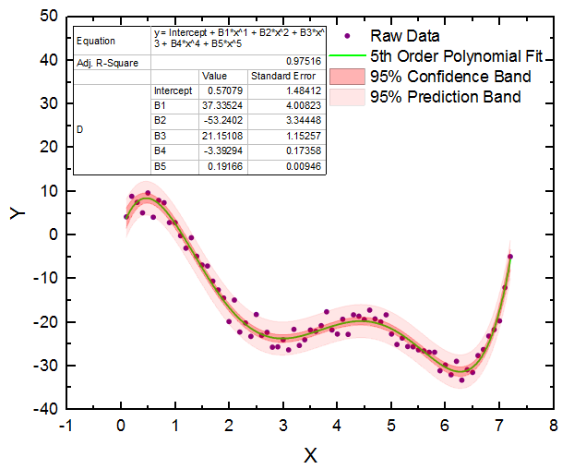
What is polynomial regression?
Some curvy data can be modeled by a polynomial regression

Slide 25
Classification
A supervised learning approach
Categorizing some unknown items into a discrete set of categories or “classes”
Classification determines the class label for an unlabeled test case

Slide 26
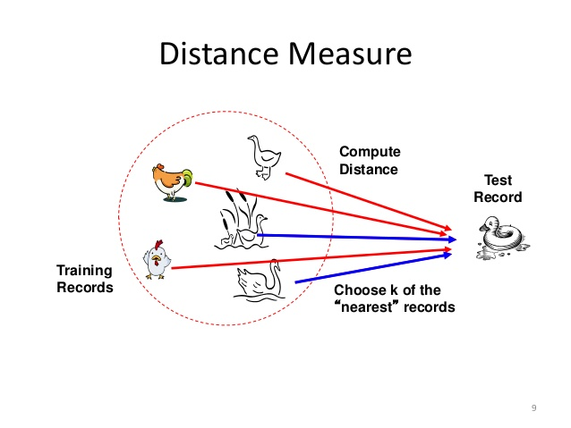
K-Nearest Neighbors
A method for classifying cases based on their similarity to other cases
Cases that are near each other are said to be “neighbors”
Based on similar cases with same class labels are each other

Slide 27
KNN algorithm
Pick a value for K
Calculate the distance of unknown case from all cases
Select the K-observations in the training data that are “nearest” to the unknown data point
Predict the response of the unknown data point using the most popular response value from the K-nearest neighbors

Slide 28
Classification : Evaluation Metrics
F1-score
Confusion Matrix
Precision = TP / (TP + FP)
Recall = TP / (TP + FN)
F1-score = 2 x (Precision x Recall) / (Precision + Recall)

Slide 29
Decision Tree
Decision trees are built by splitting the training set into distinct nodes, where one node contains all of, or most of, one category of the data.

